Slide 1
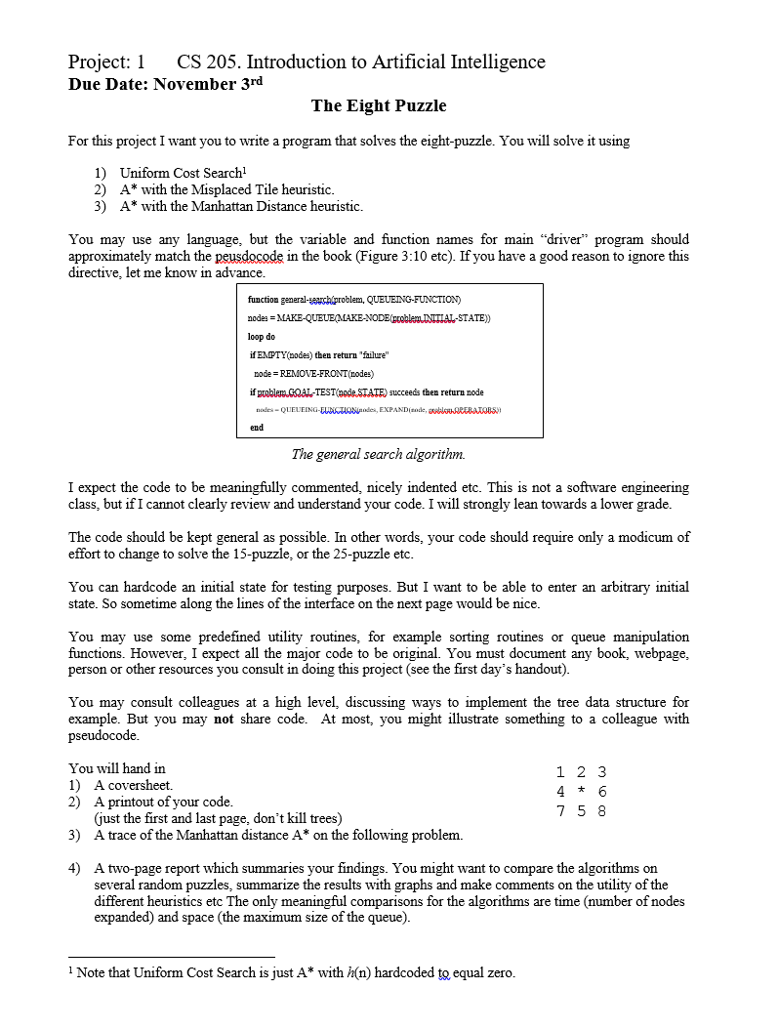
Project 1
Project_1_The_Eight_Puzzle.doc

Slide 2
Read the project handout.
Read the project handout.
Read the project handout.
This is not hard or complicated ;-) I can do this in 24 lines of Matlab. If you find yourself writing hundreds of lines of code, stop, think and start again.
You need to write a report that has your findings. Here is a hint, your findings will be:
For shallow problems, it does not matter too much what heuristic you use, if any.
As the problems get harder, heuristics help more and more.
A good heuristic is better than a weak heuristic.
You need to write a “A two to five -page report which summaries your findings”. I expect this report to be well written, coherent and largely free of misspellings/typos/poor grammar. I expect clean, well thought out figures and/or tables.
The basic story of the report is: For simple problems (only slightly “messed-up” puzzles), having a heuristic does not make a difference. However, for harder puzzles, having a heuristic like Misplaced Tiles helps, and having a tight heuristic like Manhattan distance really helps.

Slide 3
Don’t cheat
If you copy a single line of text, or a single line of code without proper attribution, I will fail you.
I am better at catching cheaters, than you are at cheating.

Slide 4
Test cases
Oh Boy
8 7 1
6 * 2
5 4 3
IMPOSSIBLE: The following puzzle is impossible to solve, if you can solve it, you have a bug in your code.
1 2 3
4 5 6
8 7 *
Trival
1 2 3
4 5 6
7 8 *
Very Easy
1 2 3
4 5 6
7 * 8
Easy
1 2 *
4 5 3
7 8 6
doable
* 1 2
4 5 3
7 8 6

